Slide 1
Multi-stage ranking & retrieval
An introduction to machine learning pipelines under low latency constraint

Slide 2
About Myself
ML Software Engineer at FB Marketplace, Product Intelligence Team
Worked at Walmart ecommerce on Query Understanding and Product Ranking
Worked with early stage startups in online advertisements
  versatile problem set
    Budget Optimization
    Bid Price prediction
    Time series forecasting
Masters CS from NC State (jumped ship from Computational Security to ML)
  Concentrated heavily on Statistics, Probability, Queuing Theory, Sampling Theory
  Particularly focused on Covariate Shift In Sentiment Analysis and Graph Mining
Undergrad : A serious crypto nerd, researched on secure key exchange and authentication protocols

Slide 3
Need for speed
    “It is better to be alive and wrong or right and dead?”
                - Jay Kreps, A Few Notes on Kafka and Jepson (2013)

Slide 4
Scale
Amazon : ~700+ million SKUs
Walmart ecommerce : ~100 million SKUs
Facebook : 20-30 million active ads
Tinder : 8+ million users

Slide 5
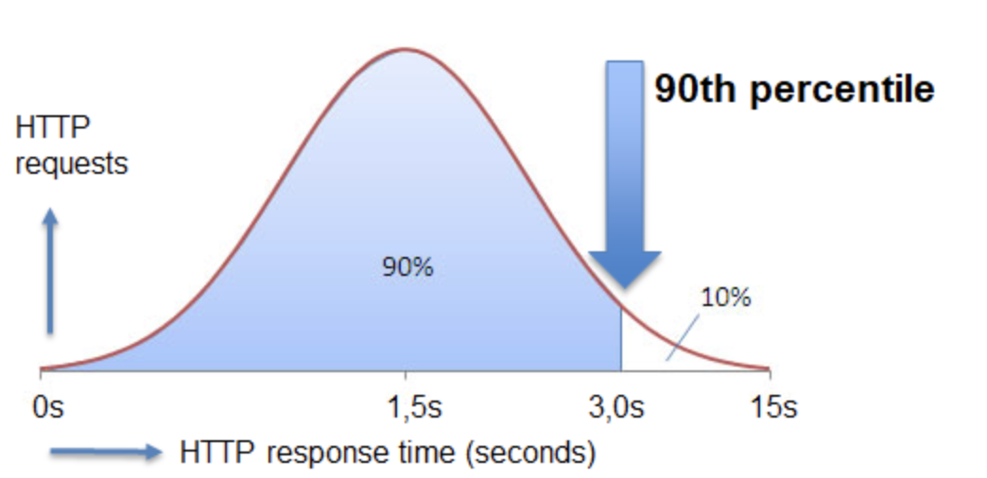
Latency Constraints
Ad Exchanges : 120 ms
Facebook Ads : 700 ms
Page Load (holiday season : 30x traffic)
  Amazon desktop: 2.3 seconds
  Walmart desktop: 4.73 seconds
  Amazon mobile: 1.14 seconds
  Walmart mobile: 5.56 seconds

Slide 6
Retrieval 101
Inverted Indexes
Relevance Score
Tree Based Indexing
Bit Map Indexing

Slide 7
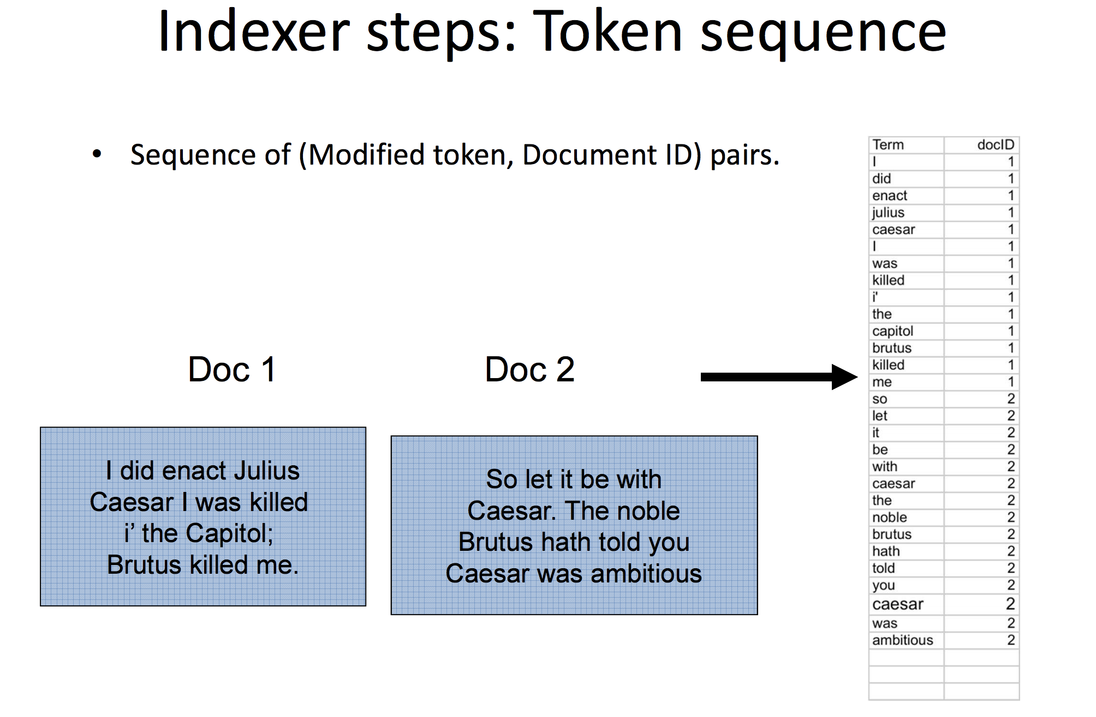
Inverted Index
http://web.stanford.edu/class/cs276/course_schedule.html

Slide 8
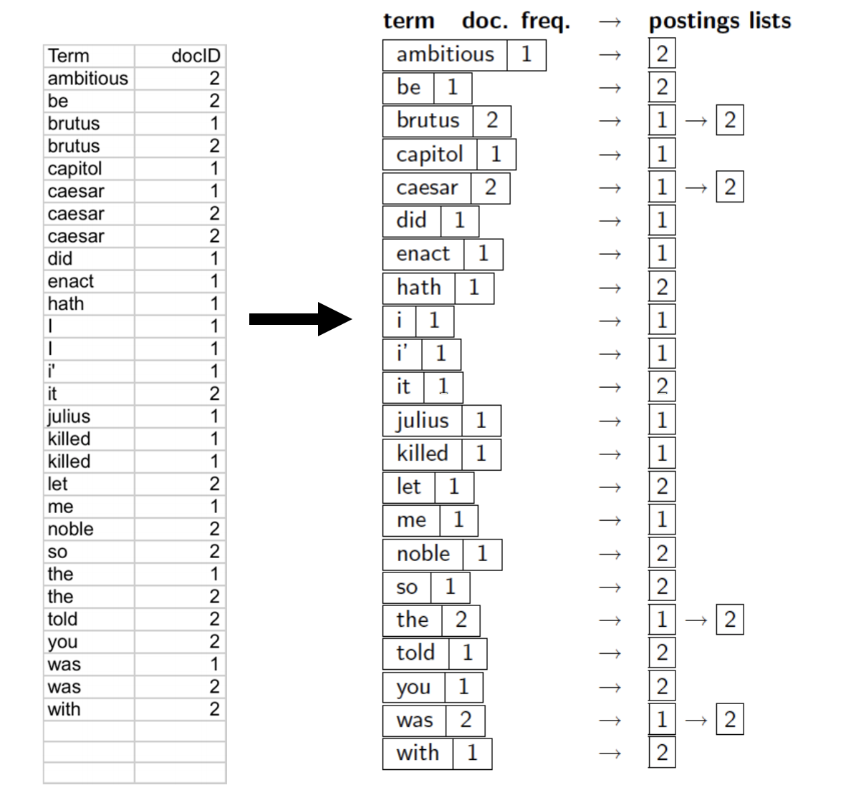
POSTING LISTS
http://web.stanford.edu/class/cs276/course_schedule.html

Slide 9
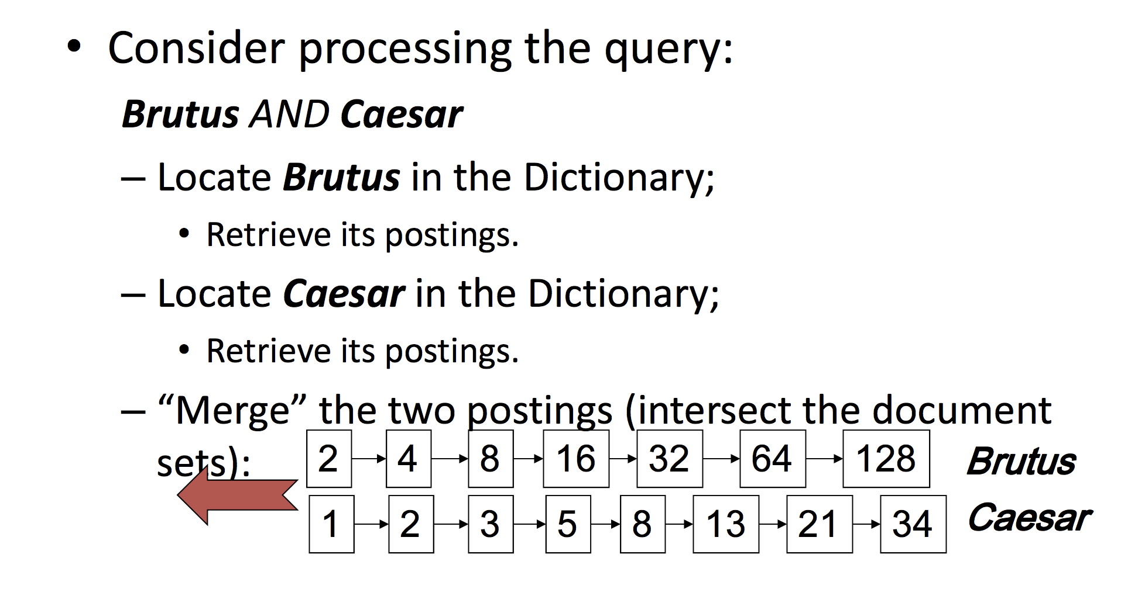
Boolean Retrieval
http://web.stanford.edu/class/cs276/course_schedule.html

Slide 10
Product Attributes
Key(ProductId_123456789) :
{
Title : Levi's Men's 550 Relaxed Fit Jeans
Description : Wash And Dry Inside Out With Like Colors; Liquid Detergent Is Recommended, Loose through seat and thigh, Straight leg
Category : Clothing > Men > Jeans > Regular Fit
Brand : Levi,
Size : 34W x 32L
Color : Blue
Fit Type : Regular
Material : Cotton
Image : http://...
Product Id : 123456789
}

Slide 11
Bird’s Eye View
Query
Query
Understanding
Service
SOLR/
Inverted Index
Product
Ranking
Attributes

Slide 12
Ad Unit
Targeting Parameters
  Country : US
  City : San Francisco
  Device type : Mobile
  Gender : Male
  Age Range : 20-24, 24-28
  Interests : {Motor Bikes, Motorcycle, Motorbike Races, Sports, Extreme Sports, ..}
  ...

Slide 13
Ad Indexing
1. Tree Based : Low cardinality Keys
2. Bit Map : High Cardinality Keys

Slide 14
Tree Based Indexing
Country
US
Gender
Male
Device
Type
Mobile

Slide 15
Bit Map Indexing
Key | AdID 0 | AdID 1 | AdID 2 | AdID 3 | AdID 4 …..
News | 0 | 0 | 0 | 1 | 1
Sports | 1 | 0 | 1 | 0 | 0
Travel | 0 | 1 | 0 | 1 | 0

Slide 16

Ad Retrieval & Ranking
20-30 million
Ad Indexer
Deep NN
Model
Ranking
Ad
DB
Light Interaction Model
Tree
Indexer
Bit Map
Indexer
Two Tower
Model
Fetch Ads
Service
Ad
Quality Model
200k ads
25k ads
5k-6k

Slide 17

Two Tower Model
https://blog.tensorflow.org/2020/09/introducing-tensorflow-recommenders.html

Slide 18
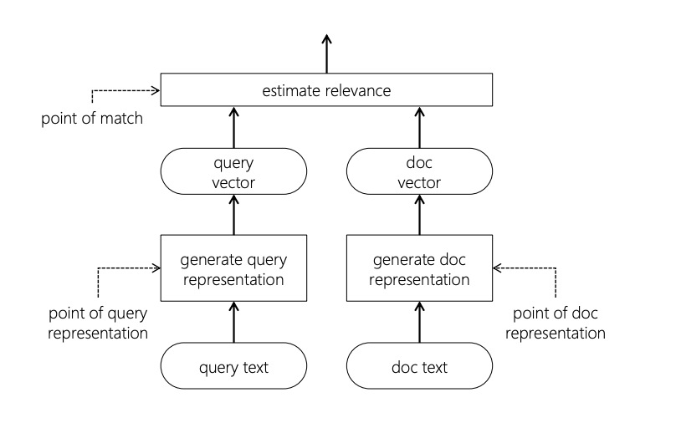
Two Tower Model
Ads : Precompute user & ad embedding
Ecommerce :
  Generate query embedding in real time
  Cached product embedding

Slide 19
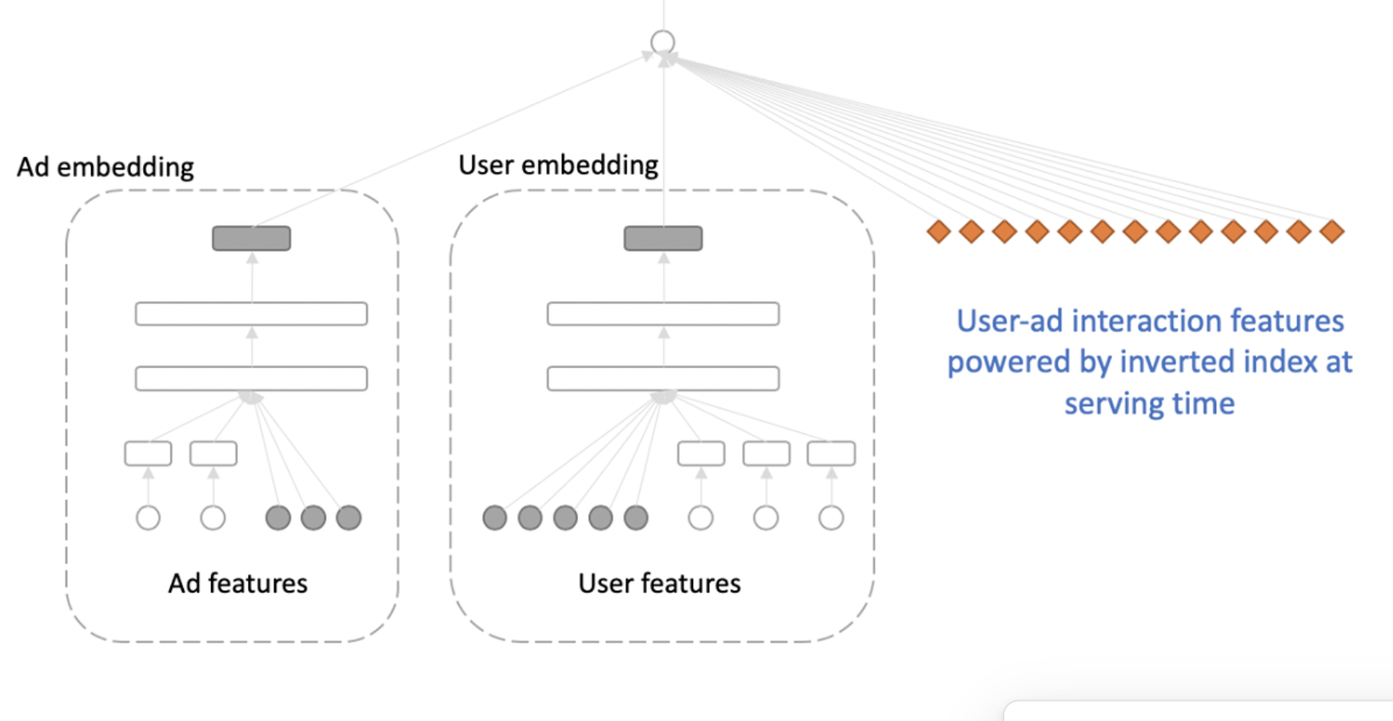
Light Weight Interaction Model
All features are cached for within indexer for quick retrieval

Slide 20
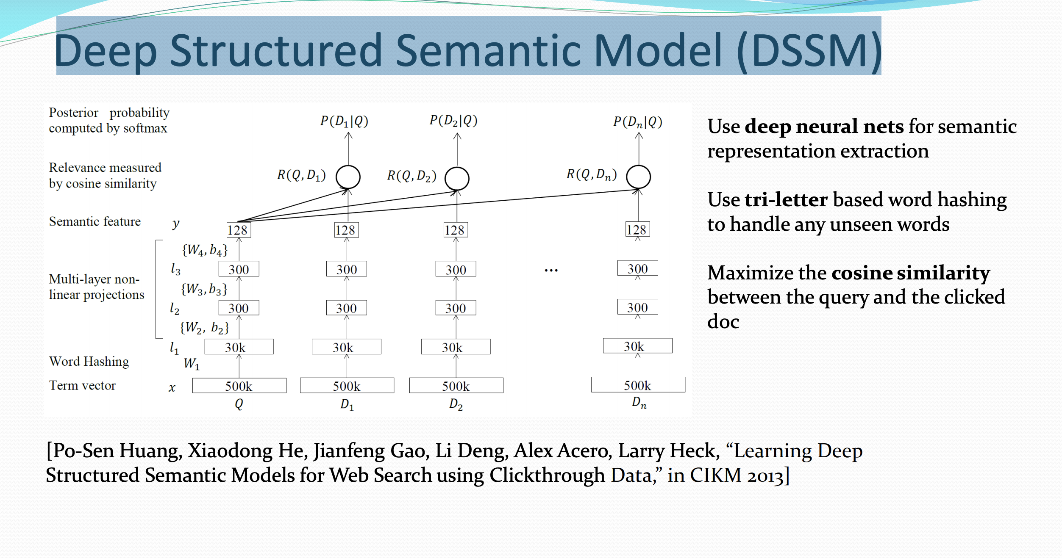
https://www.microsoft.com/en-us/research/wp-content/uploads/2016/02/DSSM_cikm13_talk_v4.pdf

Slide 21
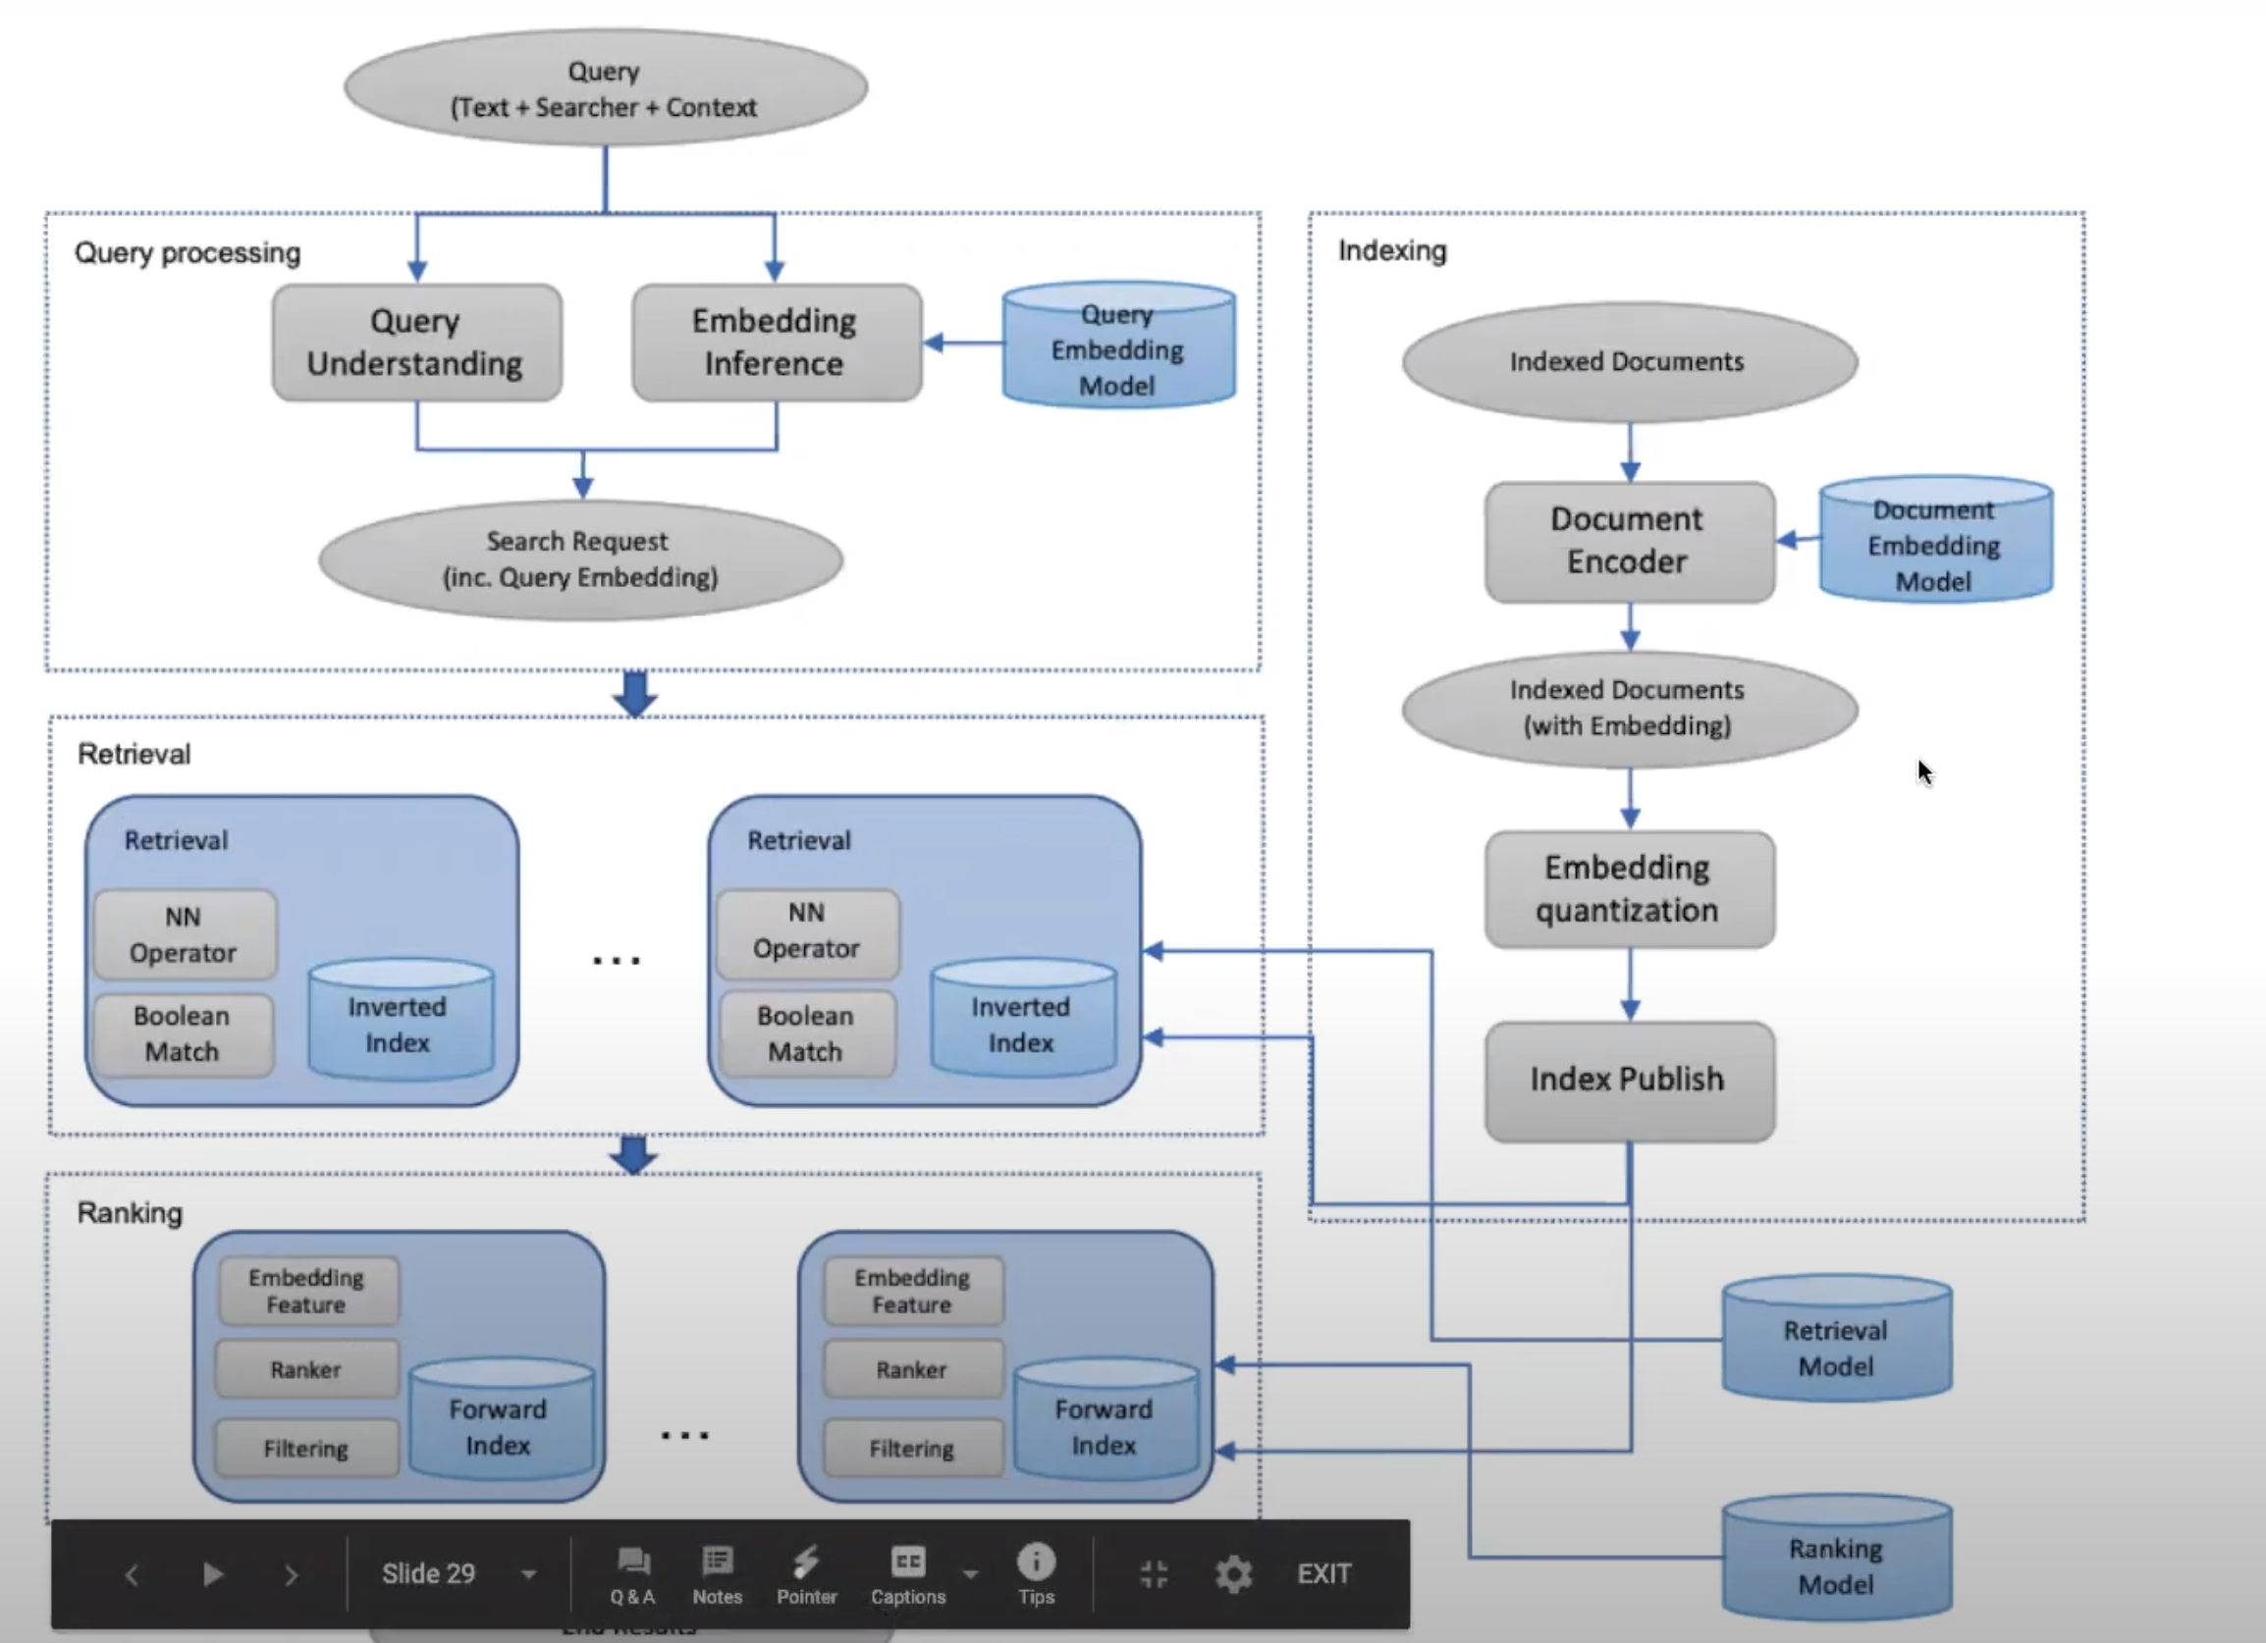
Process Flow

Slide 22
End of part 1
Questions ?

Slide 23
Session Recommendation
As Approximate Nearest Neighbor
Generate Image/song/product embedding
  Engagement data
  Like matrix factorization
  Contrastive loss if categorical data
Build Indexes
  Tree-based approaches Hashing-based approaches
    KD-Tree . Locality-sensitive hashing (LSH)
    Vantage Point Tree PCA hashing
    (Random) Projection Tree Min-hashing
    Ball Tree Spectral hashing

Slide 24
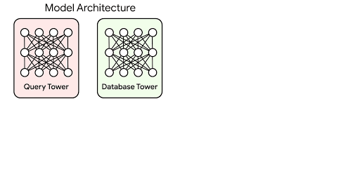
Embedding Space
https://ai.googleblog.com/2020/07/announcing-scann-efficient-vector.html

Slide 25
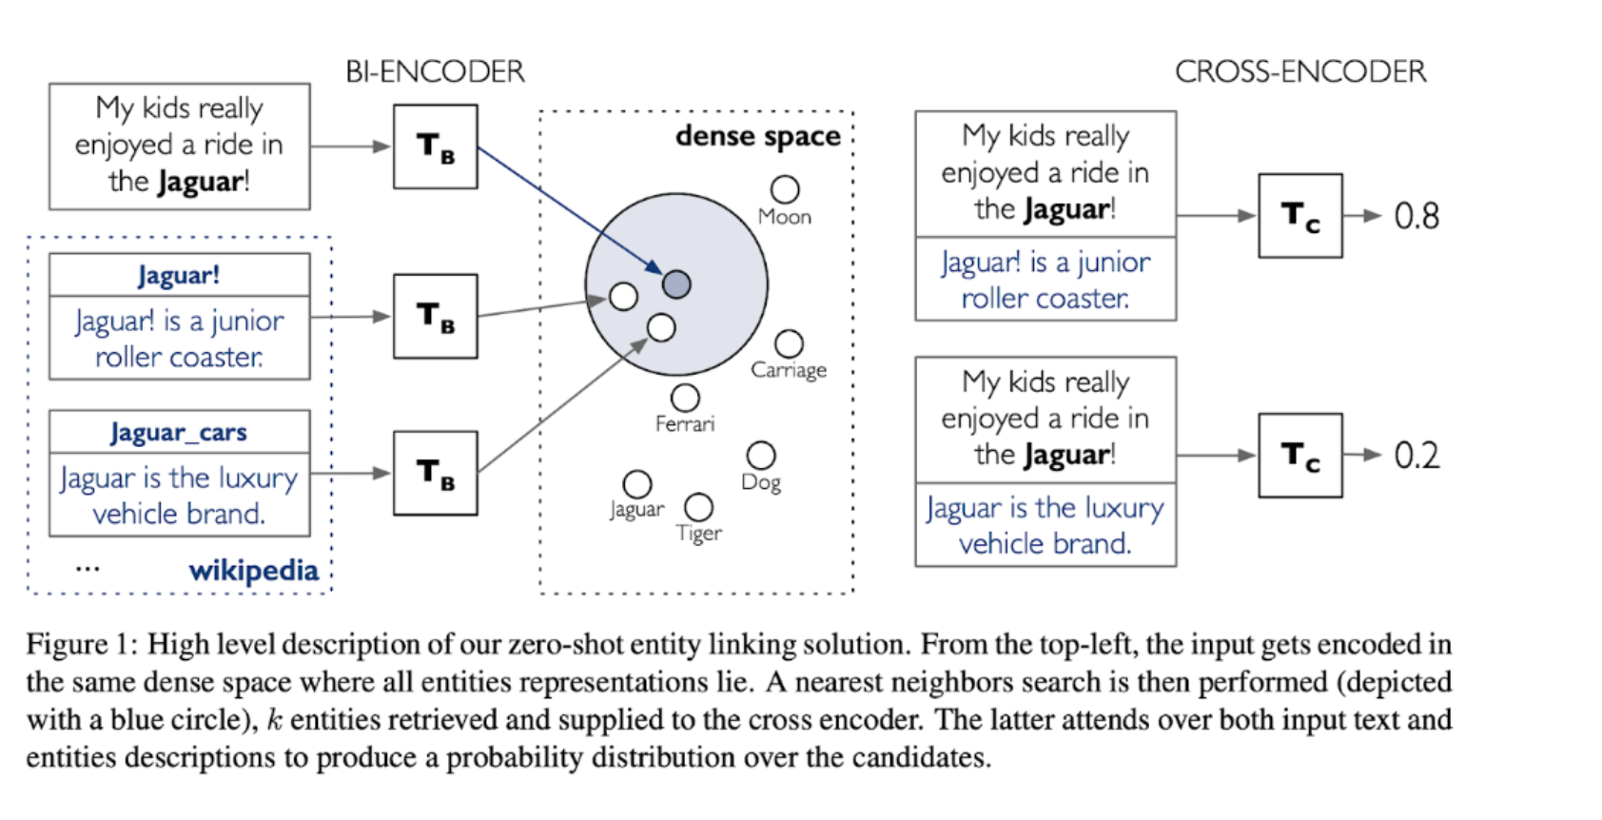
Search In Embedding Space
Zero-shot Entity Linking with Dense Entity Retrieval

Slide 26
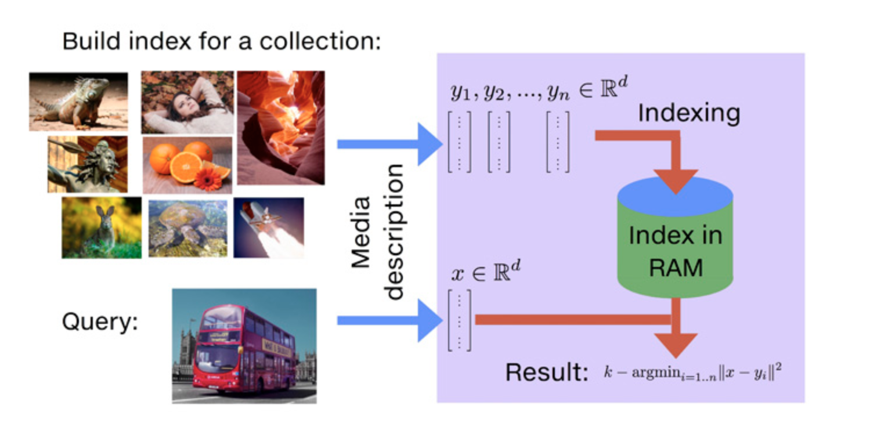

Slide 27
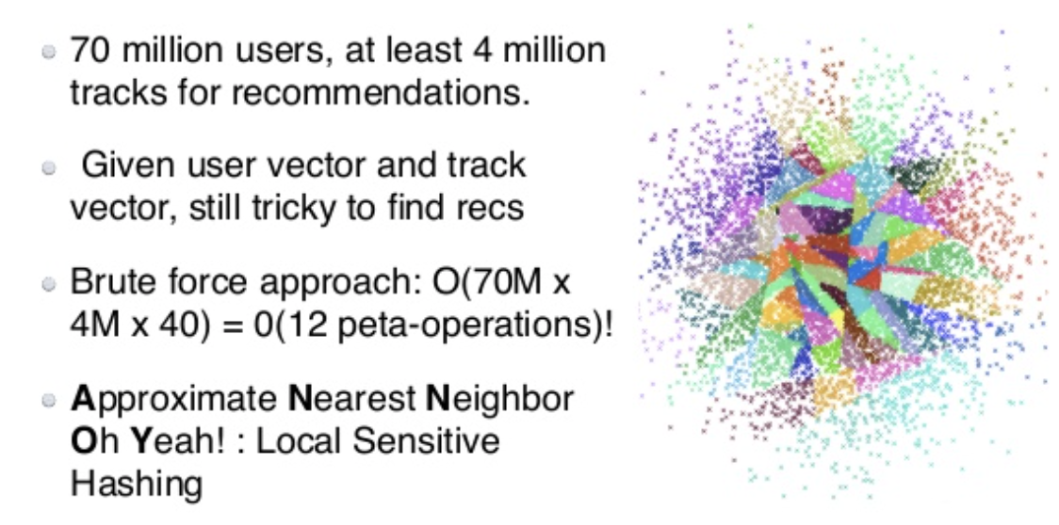
Spotify Use Case
https://www.slideshare.net/vidhyamurali/cf-models-for-music-recommendations-at-spotify

Slide 28
Popular Embedding Libraries
Spotify Annoy
Facebook Faiss
Google ScaNN

Slide 29
Questions

